Slide 1
Healthy air together –
when scientific and industrial advances meet
the needs of society

Slide 3
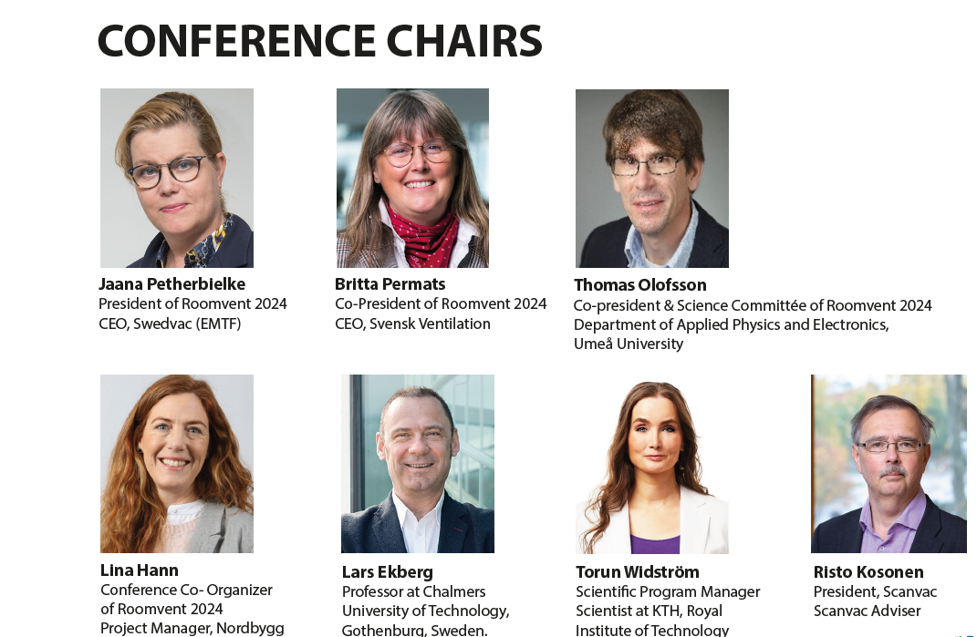

Slide 5
