Slide 1


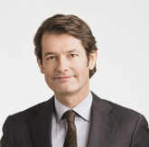
Corporate presentation
Sep 2020
Henrik Nittmar, PhD
CEO

Slide 2

About us
Public company listed on NASDAQ First North Growth market (CLBIO)
Clinical stage drug development company, focusing heparin-based substances to improve outcome of organ transplantation and cell therapies
Building a medical device business based on clinically proven antithrombotic coating capability – more than 100,000 patients have been implanted with CHC™ modified devices.
10 employees in Uppsala in development, quality, regulatory and manufacturing
Manufacturing facility for medical device business in Uppsala
Solutions for Life
2

Slide 3

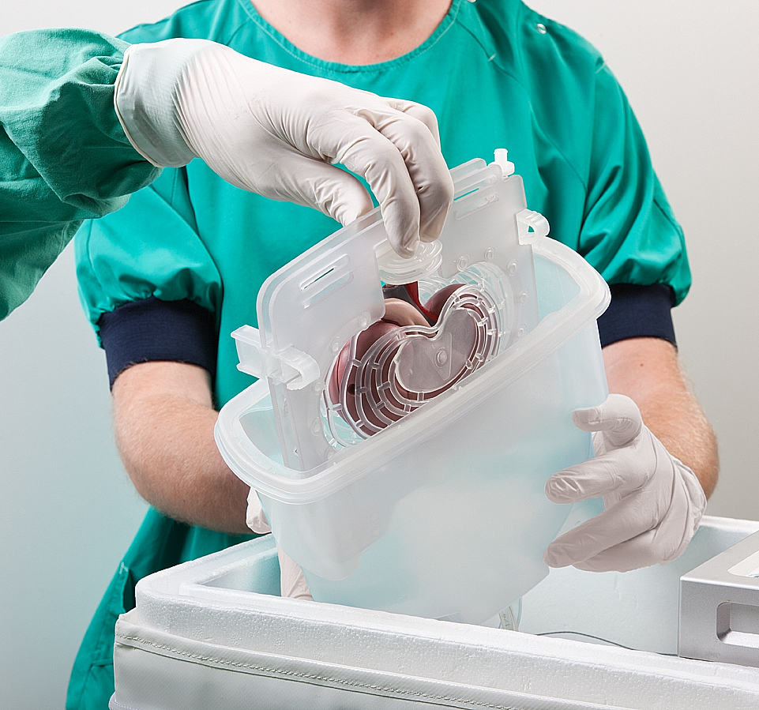
Clinical stage drug development company targeting Ischemia-Reperfusion Injury in solid organ transplantation & medical device coating
  Phase 1 trial lead candidate Renaparin® in kidney transplantation, top-line results for safety presented in June 2020
  Preparing multi-center phase 2 kidney transplantation study
  Orphan Drug designation by EMA and FDA
  Preclinical evaluation of additional organ transplantation areas, e.g. lung transplantation
  Building customer base for medical device coating applications
  Public company listed on Nasdaq First North Growth Market (CLBIO)
  HQ and production unit in Sweden
  Outsourced GMP manufacturing for pharmaceutical development and market launch
  Heparin based technology. 100,000+ patients implanted w/ Corline heparin modified coronary stents
Development status
Company
3

Slide 4
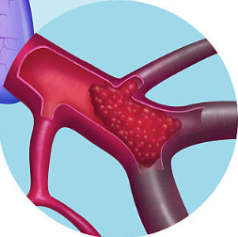
Ischemia/Reperfusion Injury in kidney transplantation constitutes a significant unmet clinical need
ISCHEMIA REPERFUSION INJURY (IRI)
ORGAN PRESERVATION IS A MAJOR FACTOR
Reduces clinical efficacy of kidney transplantation
40 % of all kidney transplantations
IRI Leads to delayed graft function (DGF)
Adds 10-14 days at ICU
IRI is associated with decreased graft function and survival
Cost of transplantation: 100,000 USD + ICU at 2,500 USD/day
During preservation, the kidney lacks natural blood flow and consequently has insufficient oxygen supply (ischemia)
Ischemia causes blood vessel damage manifested as endothelial activation and shedding, and when kidney is connected to the recipient’s blood flow, an immune thrombotic reaction will occur (reperfusion injury)
… and there is currently no drug approved for prevention of IRI/DGF
4

Slide 5

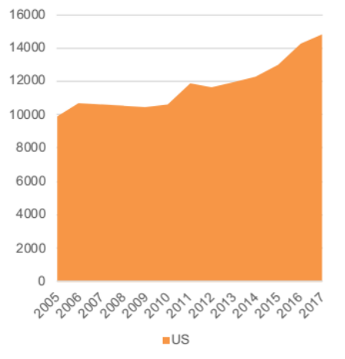
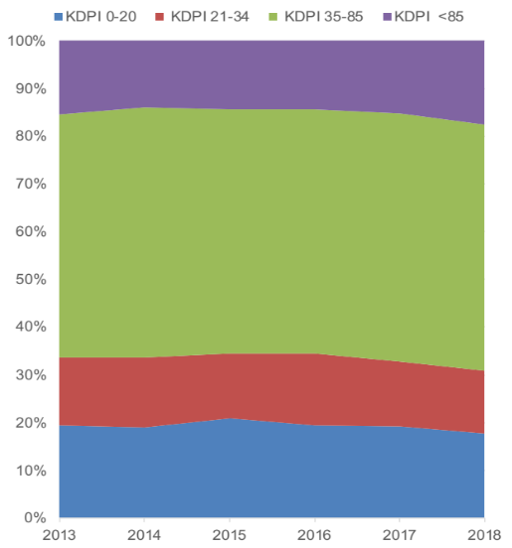
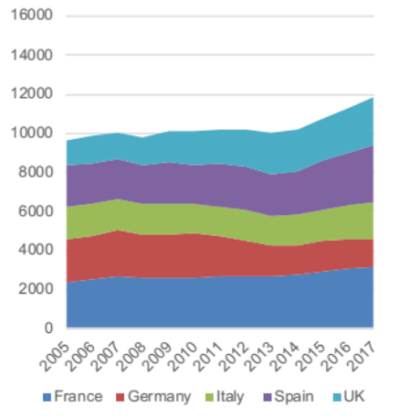
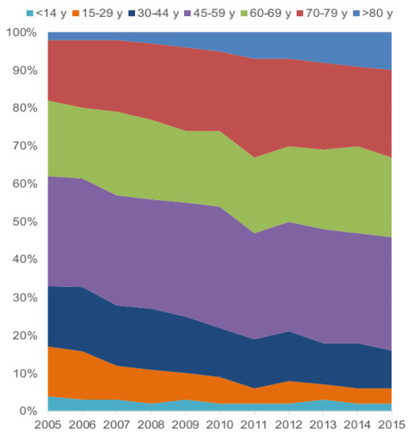
Increased use of marginal deceased donors drives incidence of IRI/DGF
Deceased Donor transplants/year
Increase of high KDPI and ECD donors
The caveat
Every day, 20 people in the US and 10 people in Europe die while on the transplant waiting list. Making better use of marginal donors may help balance organ shortage.
# DD transplants 2005-2017 in US
KDPI segment dynamics 2013-2018, US
Marginal donors, i.e. high kidney donor profile index (KDPI) and extended criteria donors (ECD), are more susceptible to IRI/DGF
# DD transplants 2005-2017 in EU 5
EU5
Accepted donor age 2005-2015, Spain
Source: OPTN,: CORLINE KOL survey, June 2019 GroupH
5

Slide 6
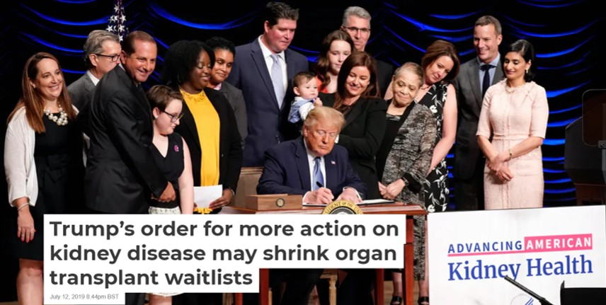
And the US administration is leading the way to future segment growth
  Executive order in July 2019 aimed “at increasing access to kidney transplants by modernizing the organ recovery and transplantation systems and updating outmoded and counterproductive regulations” (=> more marginal donors)
  “Official goal is to double the amount of available kidneys by 2030”, which means adding more than 20,000 kidney transplantation procedures
6

Slide 7
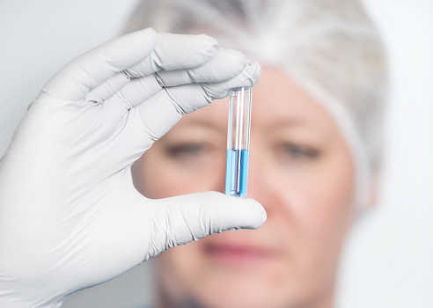
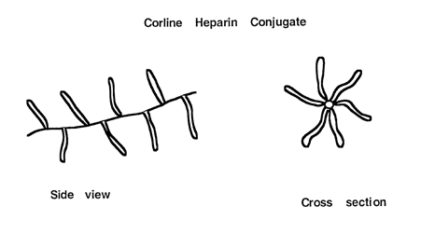
Corline’s approach to prevention of IRI/DGF relies on surface modification of the kidney endothelium with innovative heparin technology
The CHCTM technology is a proteoglycan-like conjugate of covalently bound heparin, used to modify surfaces on medical devices, cells and the vasculature of solid organs
CHCTM modification reduces activation of coagulation, complement and inflammation. CHC thus attenuates immune thrombosis
7

Slide 8

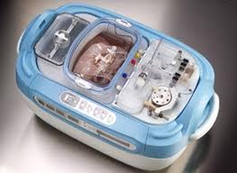

Renaparin® is administered ex vivo to the donor organ
Restores/Repairs vessels in the kidney (endothelial repair), emulating a coherent vascular glycocalyx
Prevents Ischemia/Reperfusion injury in kidney transplantation by presenting a repaired endothelium and attenuating the reperfusion injuries
Used with all standard perfusion solutions, cold storage and machine perfusion
Goal is to avoid delayed graft function, and thus reduce need for dialysis, duration of hospital stay and improve kidney function/survival
THE DONOR KIDNEY IS TREATED WITH RENAPARIN® DURING PRESERVATION
Explant of kidney
Renaparin®
Transplantation
Ex vivo treatment
8

Slide 9
Renaparin® shows promising results from proof-of-concept studies in small animals…
Rapid effect of treatment¹
Initial effect translates into remaining functional benefit²
P=0.026
P=0.035
S-Creatinine (µmol/L)
S-Creatinine (mg/dL)
Untreated
Renaparin®
Baseline
Day 4
Day 7
= control group
= Renaparin®
Transplantation to mice n=6, 24 hrs
Transplantation to rats n=14, 7 days
9
Source: (1) Nordling, et al 2018., (2) Corline proprietary non-published data.

Slide 10
… and the treatment effect translates to large animals
P=0.031
Creatine (µmol/L
Total urine volume (mL)
P=0.023
Time (min)
= control group
= Renaparin®
Porcine ’ex vivo transplantation’
n=6, 3 hrs
Porcine ’ex vivo transplantation’
n=6, 3 hrs
10
Source: (1) Sedigh et al, 2018.

Slide 11
Clinical safety and tolerability have been shown in a recent phase 1 study
  16 patients (8 Renaparin®, 8 placebo) at 3 Swedish sites
  Transplantation performed with Renaparin® or placebo treated kidneys
  Last patient recruited in Feb 2020
  30 days follow-up
  Study top-line results reported in June 2020
  Primary and secondary safety endpoints were successfully evaluated – it was concluded that Renaparin® administration is safe and tolerable for this indication and dose
  Full analysis of data set is currently being performed – update in
  September 2020
11

Slide 12
Phase 2 clinical trial design
  Primary objective is to determine the efficacy of Renaparin® to improve outcome of kidney transplantation by prophylaxis of Ischemia/Reperfusion Injury in deceased donor kidney recipients
  Secondary objectives are dose confirmation/evaluation and safety
  Target population is recipients at increased risk of developing DGF (ECD-DBD, DCD) = “marginal donors”
  Primary end-point will be short-term (7-10 days) cumulative creatinine level. Supportive and secondary endpoints will include phase 3 pivotal endpoints (DGF and eGFR)
  30 days efficacy follow-up, 12 months safety and exploratory long-term efficacy
  Multi-center in EU and US, ~120 patients at 10 sites
  Design to be updated based on full analysis of Phase 1 data
12

Slide 13
IP and Regulatory
INTELLECTUAL PROPERTY
REGULATORY PLAN
Approved patents in US and China for using Renaparin® in solid organ transplantation. Expires in 2034.
“Intent to approve” letter from EU patent authorities in July 2020
Orphan Drug designation renders 7 and 10 years of market monopoly in the US and EU respectively, no matter the patent situation at the time
Manufacturing process is protected by advanced know-how accumulated during 20+ years of in-house experience
Ph 1 development in Sweden, 3 sites, concluded
More than 100,000 coronary stents have been modified with CHC/Renaparin® and implanted in patients in Europe
Orphan designation in US and EU for solid organ transplantation
Protocol assistance Ph 1 with EMA 2015
Pre-IND meeting with FDA Oct 2019, focusing Ph 2 and 3 requirements
Protocol assistance Ph 2 with EMA March 2020 – equal response comp to FDA.
Corline will seek additional regulatory status to alleviate cost burden and speed up development, e.g. Fast track, Breakthrough Therapy etc.
13

Slide 14
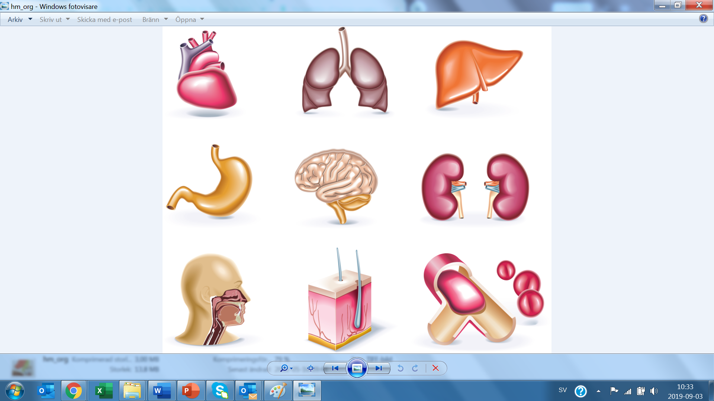
IRI/DGF prevention in solid organ transplantation – development priorities
Kidney
1
Hypothermic Machine Perfusion (all preservation solutions)
Static Cold Storage
Lung
2
Static Cold Storage (Perfadex/Plus)
EVLP
Liver
3
Hypothermic Machine Perfusion
Normothermic Machine Perfusion
Static Cold Storage
14

Slide 15
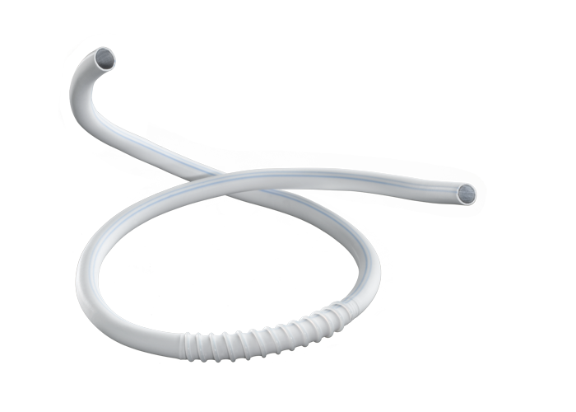
Customer development for medical device coating
Corline maintains capability to heparin modify implants in order to secure function and reduce patient risks
More than 100,000 coronary stents have been modified with CHC™ to improve blood compatibility
LOI and development agreement for out-licensing of technology for ablation catheter application and in development process with 5-7 other customers in different stages of feasibility testing and process development
Significant revenue potential for application of CHC™ in medical devices
15

Slide 16
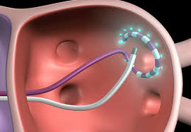
Medical device revenue potential – the ablation market case
Atrial fibrillation (AF) affects more than 37 million worldwide, incidence is expected to increase significantly
AF can lead to ischemic stroke due to blood clots releasing from the heart, heart failure and myocardial infarction. Each year, more than 750,000 people are hospitalised and 130,000 patients die as a consequence of AF
Ablation catheters are used to treat AF by scarring tissue in the heart and prevent abnormal electrical signals moving through the heart. Procedure lasts 1-4 hours. One major procedural risk is blood clotting caused by catheter
Ablation catheter procedure cost are in the 30-50,000 USD range, and ablation catheters are between 5-10,000 USD. The global AF market was estimated at 5 bn USD in 2018 and is expected to grow to 12 bn USD by 2025
Corline has estimated a 50 MSEK annual revenue potential from its current non-exclusive customer relationship
16

Slide 17
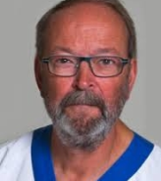
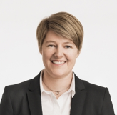
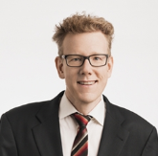
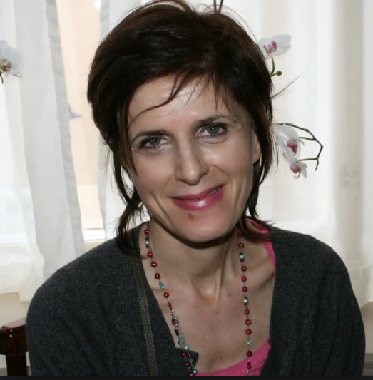
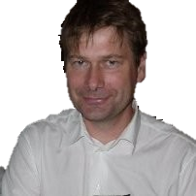
Management
Henrik Nittmar, PhD
CEO
Gunnar Tufveson, Prof, MD
Chief Medical Officer
Henrik Nittmar, CEO of Corline since 2008, has a background in Technology and Innovation Management. He is founding partner of four high-tech companies and currently serves as Non-Executive Board Member of PiezoMotor Uppsala AB, a worldwide supplier of high-tech micro motors. Henrik holds a Master of Science in Industrial Engineering and Management from Chalmers University of Technology, as well as a PhD in Innovation Management from the Stockholm School of Economics.
Prof. Tufveson has a background as a clinically active surgeon in the fields of kidney transplantation and transplantation of islets to patients with diabetes type 1. He has conducted research in both fields and is the author or co-author of more than 250 peer-review papers.
Jessica Magnusson, MSc
Regulatory and Quality Assurance Manager
Fredrik Carlsson, PhD
Research Manager
Jessica has over 15 years’ experience in the Medical Device Industry where she has worked both in Production, Development and Quality Assurance. As Corline’s Regulatory Affairs and Quality Assurance Manager, Jessica supports development projects from A to Z and has a key role in project and product delivery. Jessica holds a Master of Science in Biotechnology Engineering from Uppsala University.
Fredrik Carlsson is an immunology scholar from the Uppsala University and has researched human innate immunity for over 10 years. He has extensive experience in pre-clinical animal and in-vitro models related to blood coagulation and complement system activation. During several years, Fredrik was an affiliate of the Nordic Islet Center, which is certified to use Islet of Langerhans in clinical transplantation to cure diabetes type 1 patients. He earned his PhD in Experimental Immunology from the Uppsala University in 2007.
Patrizia Caldirola, PhD
Project Manager Renaparin®
Lars Olsson, PhD
Consultant Head of CMC
Patrizia has over 20 years’ experience in the pharma industry, from preclinical through clinical development. She has worked in pre-clinical development teams and as project manager and director in companies such Pharmacia, BioVitrum and Karolinska Development. Patrizia is responsible for managing the development of Renaparin® through current clinical development. Patrizia has a PhD degree in Medicinal Chemistry from Vrije Universiteit Amsterdam.
Lars has over 15 years’ experience of pharma development where he has worked in managerial and strategic roles in the area of Chemistry, Manufacturing and Control (CMC). He has been employed in leading development roles in AstraZeneca, Medivir, Acadia and KaroBio, and held the position of Vice President, CMC for Wilson Therapeutics until the company was acquired by Alexion in 2018. Lars holds a PhD in Organic Chemistry from the Stockholm University.
17

Slide 18
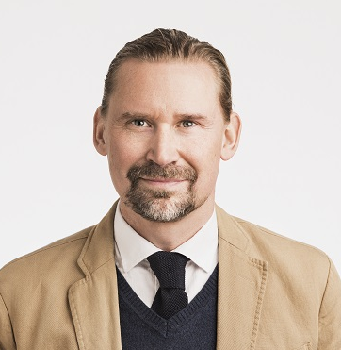
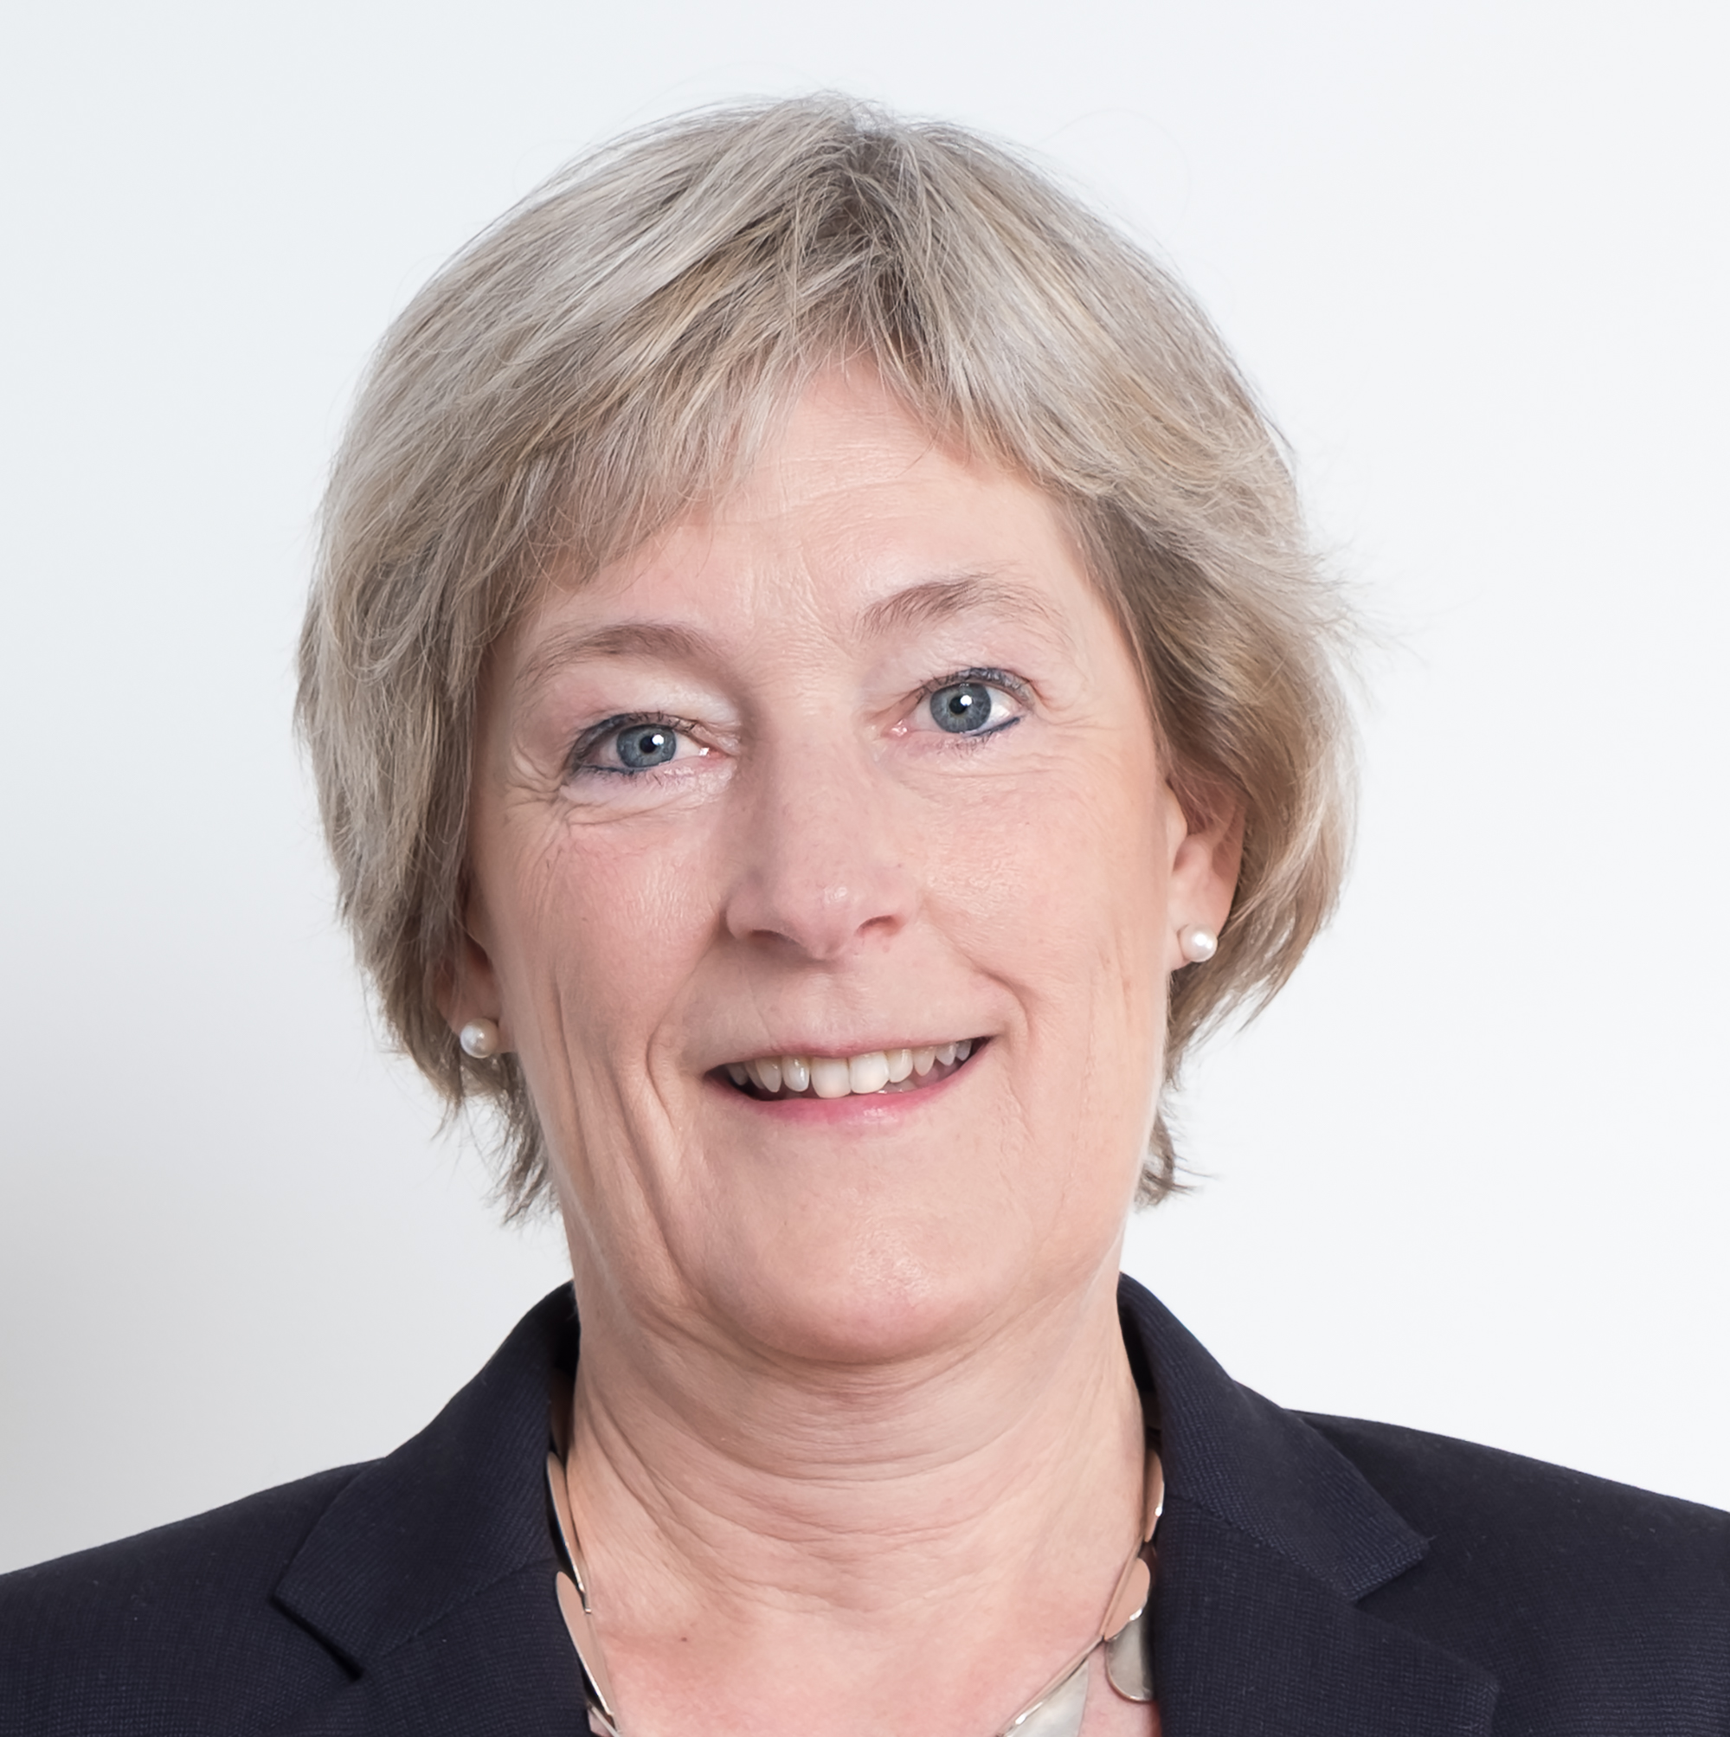
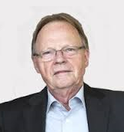
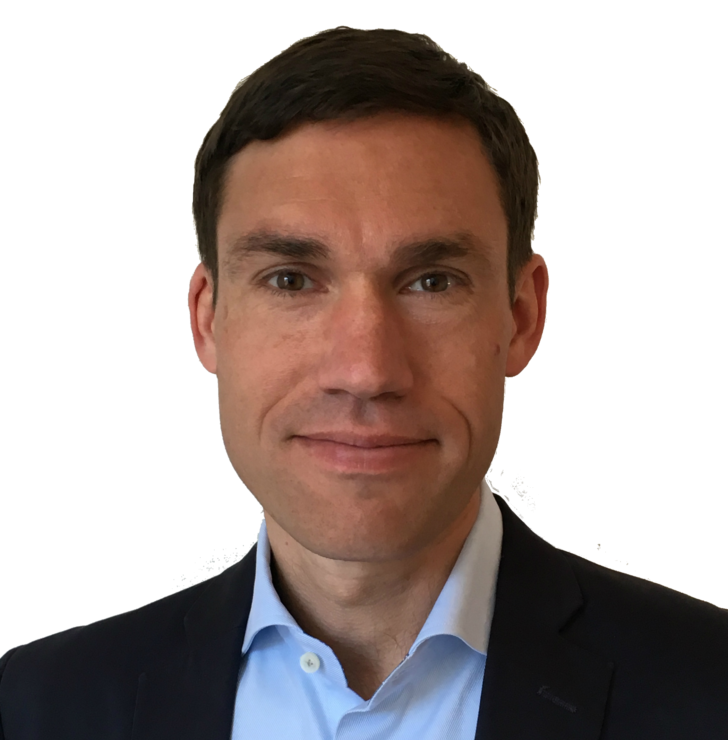
Board of Directors
Adam Dahlberg
Chairman
Gunilla Ekström
Board Member
Adam is a Swedish Investor and Manager overlooking a diverse portfolio of shareholdings. Adam is also a member of the Crafoord family, most known for the establishment of the Swedish Medical Device company Gambro AB. Among others, he has invested in Qlik Technologies, a high-growth software company in Business Intelligence, PiezoMotor Uppsala AB, a game-changing technology company (micro motors) and Senzime AB, a company developing and marketing innovative patient monitoring systems.
Gunilla Ekström has extensive experience of managing advanced pre-clinical and clinical pharmaceutical development projects and organizations. Having worked some 30 years in the pharma industry, her background includes companies such as AstraZeneca, where she was Global Product Director for Analgesia, Orexo (Head of Preclinical R&D), and Karolinska Development where she assumed the role of VP Operations. In addition Gunilla serves on the board of a number of companies in the pharmaceutical industry: SP Process Development AB, Inahalation Sciences Sweden AB, Emplicure AB and NovaSAID AB.
Lars Sunnanväder
Board Member
Henrik Krook
Board Member
Lars is a serial entrepreneur of Swedish origin, focusing in the Medical Device and Biotech industry. Since 1982 he was founding CEO and Chairman of Jostra AG, a company that grew to be market leader in Cardiac Surgery in Europe (sold in 2003 to Getinge AB). During his career, he successfully founded, grew and exited a number of other ventures, such as Joka Kathetertechnik GmbH, Jomed AG or Jolife AB. Today Lars is CEO of Bentley Innomed GmbH and Director of the LS Medcap Holding Company. He is also an investing Non-Executive for many Life Sciences companies.
Henrik Krook has a broad Life Science perspective and a solid network gained from over 15 years of leader roles in settings varying from University Hospital to Big Pharma and Biotech. He has direct experience in general management, business development, clinical trial management, commercialization and strategy formulation from Roche, Novartis, Medivir and Alexion. Henrik is currently in the transition from being General Manager for Alexion Nordics and Baltics to heading his own consultancy business to support Nordic Life Science companies with their development. Henrik holds a Master of Science in Pharmacy and a PhD in Immunology from Uppsala University as well as an Executive MBA from the Stockholm School of Economics.
18

Slide 19
Solutions for Life

