Slide 1
Vicore Pharma AB
A Rare Disease Company with Focus on Patients with Fibrotic Lung Disease
August 2020

Slide 2
Forward looking statement
  This presentation may contain certain forward-looking statements and forecasts based on uncertainty, since they relate to events and depend on circumstances that will occur in the future and which, by their nature, will have an impact on Vicore Pharma’s business, financial condition and results of operations. The terms “anticipates”, “assumes”, “believes”, “can”, “could”, “estimates”, “expects”, “forecasts”, “intends”, “may”, “might”, “plans”, “should”, “projects”, “will”, “would” or, in each case, their negative, or other variations or comparable terminology are used to identify forward-looking statement.
  There are a number of factors that could cause actual results and developments to differ materially from those expressed or implied in a forward-looking statement or affect the extent to which a particular projection is realized. Factors that could cause these differences include, but are not limited to, implementation of Vicore Pharma’s strategy and its ability to further grow, risks associated with the development and/or approval of Vicore Pharma’s products candidates, ongoing clinical trials and expected trial results, the ability to commercialize C21, technology changes and new products in Vicore Pharma’s potential market and industry, the ability to develop new products and enhance existing products, the impact of competition, changes in general economy
  and industry conditions and legislative, regulatory and political factors.
  No assurance can be given that such expectations will prove to have been correct.
  Vicore Pharma disclaims any obligation to update or revise any forward-looking statements, whether as a result of new information, future events or otherwise.

Slide 3
Vicore – at a glance
Focus
Patients with fibrotic lung disease
Pipeline
Two differentiated assets with 3 phase II studies lined up addressing >$1bn markets
Indications
Idiopathic pulmonary fibrosis (IPF), IPF cough, systemic sclerosis and COVID-19
Differentiation
Addressing fibrosis, inflammation and vasculopathy
People
Team of experienced drug developers
Share
Listed on Nasdaq Stockholm main market with a market cap of 1,300 MSEK (130 MEUR)
Main
Shareholders
HealthCap (26%), Robur, AP4, AP3, AP2, Handelsbanken and HBM Healthcare
3

Slide 4
Pipeline
Three phase II programs and one program with proven clinical efficacy
4

Slide 5
Pipeline
Project
Indication
Preclinical
Phase I
Phase II
Phase III
IPF
CTA approved
VP01
RP/SSc
COVID-19
VP02
IPF and
IPF cough
VP03
Fibrosis
Finalized
Ongoing
CTA – Clinical Trial Application

Slide 6
VP01
First in class with unique mechanism of action

Slide 7
VP01 (C21)
A first in class drug, stimulating the body's repair system, reducing tissue damage and promoting healing

Slide 8
VP01 – mode of action
VP01 is a first in class small molecule stimulating the angiotensin II type 2 receptor
ANG II
AT1R
AT2R
Angiotensin II has 2 receptors
with opposite actions
Vasoconstriction
Inflammation
Fibrosis
Vasodilation
Anti-inflammation
Anti-fibrosis
In disease ANG II binding to
AT1R dominates
ANG II
AT2R
AT1R
VP01 counteracts the ANG II effects on AT1R and is protective
AT1R
VP01
AT2R
VP01 is anti-fibrotic and anti-inflammatory through the AT2R

Slide 9
VP01
First in class anti-fibrotic for pulmonary fibrosis

Slide 10
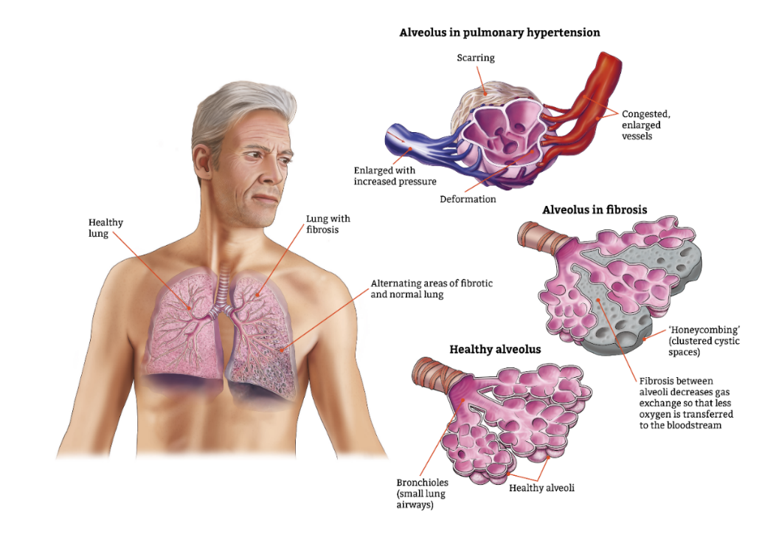
IPF
A rare interstitial pulmonary disease with unknown etiology
Male predominance
  250,000 in US and EU
Progressive disease
  3-5 years life expectancy
  Loss of lung function
  Pulmonary hypertension
Two drugs approved
  Reduce functional loss
  GI side effects
  2019 sales: $2.8 billion
An IPF patient never experiences improvement of disease or quality of life

Slide 11
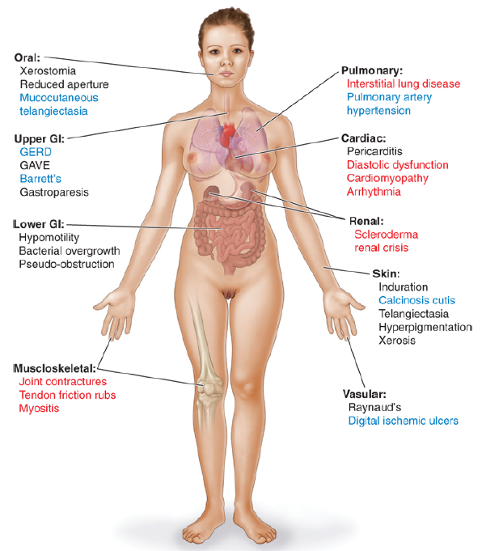
PULMONARY FIBROSIS IN SYSTEMIC SCLEROSIS
SSc is a rare autoimmune disease with heterogeneous clinical manifestations
Female predominance
  60,000 in US and EU
Progressive disease
  6-10 years life expectancy
  Loss of lung function
  Pulmonary hypertension
Only Ofev approved
  Reduce functional loss
  GI side effects
In systemic sclerosis the lung fibrosis is fatal

Slide 12
VP01 in bleomycin fibrosis treatment model
Reduction of fibrosis compared to competitors
Esbriet
Ofev
Pamrevlumab
VP01
Esbriet
Ofev
Pamrevlumab
C21
Heckmann 2016
Rathinasabapathy 2018
VP01 reduces fibrosis more than standard of care in the bleomycin model

Slide 13
VP01 product development
Product protection
  Orphan drug designation and formulation patent applications
Non-clinical safety
  3 month toxicology in rat, dog, non-human primate
CMC
  Developed as an immediate- release dry capsule
Phase I
  3 phase I studies up to 200 mg bid
    No serious adverse events, no G-I intolerability
    Thorough cardiovascular monitoring
  Food interaction
  Sufficient exposure for AT2R activation
Phase II
  Mechanistic study in SSc ongoing
  Proof of concept in IPF approved by regulatory agency
Safe and well tolerated at clinical study dose

Slide 14
VP03 – VP01 follow up compounds
Rational
  VP01 only has orphan drug designation for product protection (7-10 years)
  VP01 has some limitations with regard to drug-drug interactions
Chemistry
  There is a limited space for novel chemistry
  New proprietary classes of compounds have been developed
  and these will have NCE patent protection to 2040 and beyond
Properties
  Similar receptor selectivity as VP01 (C21)
  Less drug-drug interaction
Status
  Initiating scale-up chemistry
  Preparing for GLP toxicology
Vicore is aiming at having a follow-up compound ready when the IPF phase II study reads out

Slide 15
VP01
A novel treatment for COVID-19

Slide 16
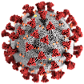
COVID-19
COVID-19 is the SARS-CoV-2 respiratory infection
It primarily affects the upper airways
  Dry cough and fever are main initial symptoms
After a few days, some patients deteriorate rapidly
  The disease changes from an upper respiratory tract
  infection to also involve the lungs
  A cytokine storm leads to acute respiratory distress with low
  oxygenation and multiorgan failure
More contagious than common flu or SARS
Mortality is estimated to 1 %
COVID-19 is a pandemic with inflammation driving morbidity and mortality

Slide 17
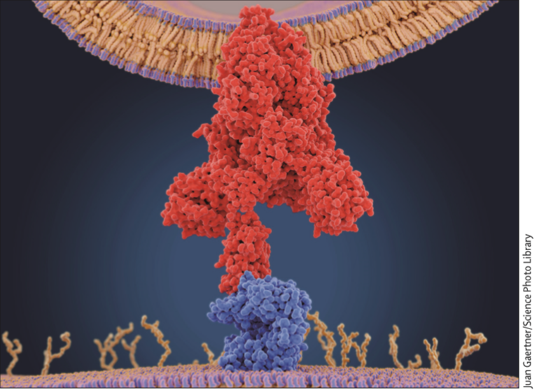
The CoV-2 virus creates an imbalance in RAS
The virus hi-jacks the enzyme ACE2 for cellular entry and triggers an imbalance in RAS leading to a
cytokine storm in the lungs (ARDS)
Direct stimulation of AT2R may bypass the incapacitated ACE2 to counteract the inflammatory drive
VP01 bypasses the RAS imbalance to prevent the cytokine storm

Slide 18
VP02
Inhaled IMID for IPF cough

Slide 19
VP02 IMID aerospere
A clinically proven drug in IPF and IPF cough formulated for inhalation to avoid systemic side effects

Slide 20
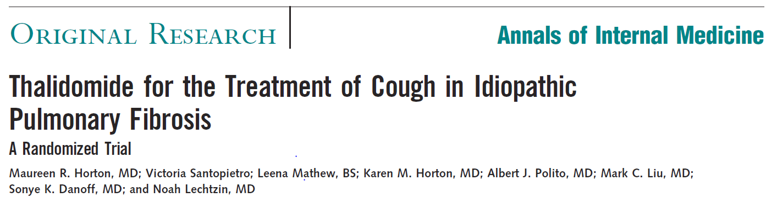



IMIDs in clinical IPF cough trial
Thalidomide orally for 3 months significantly improves cough and improves quality of life in IPF patients
VAS
Cough VAS
Quality of life scores
100
Δ Improvement
80
10
60
0
40
20
10
Δ Deterioration
Thalidomide
12 w; n=20
Δ=11.2; p=0.001
0
Months
0
3
The systemic dosing gives rise to side effects like peripheral neuropathy
Thalidomide is the only medicine that has shown improved quality of life

Slide 21
VP02 – the principle of targeted delivery
Inhaled
Systemic
Local delivery is well
tolerated with low systemic exposure and improved safety
Systemic delivery is poorly
tolerated with high risk of side effects
Drug delivered directly to the lungs, reduces the risk of adverse effects

Slide 22
The team
First class drug development team
22

Slide 23
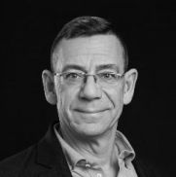



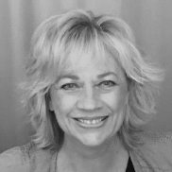
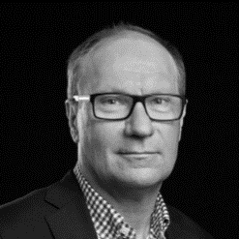
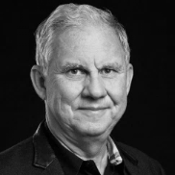
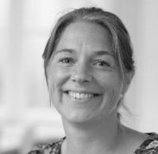

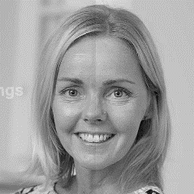
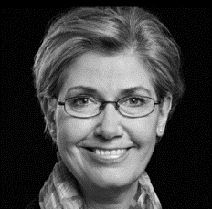
The Vicore Team
CARL-JOHAN DALSGAARD, CEO
    MD, PhD, Karolinska Institute with post-doc experience from Harvard
    Former Head of Therapy Area Pain Control, AstraZeneca R&D
    10 years of experience from senior management, AstraZeneca
    19 years of experience as Venture Partner at HealthCap
HANS JEPPSSON, CFO
    PhD, Finance with post-doc research at UC Berkeley
    Cross-disciplinary background in finance and medicine
    Former equity research analyst at Danske Bank
    Professor in Finance at the University of Gothenburg
ROHIT BATTA, CMO
    MBBS, King’s College London, MFPM
    Medical doctor with extensive industry experience in Rare Diseases
    Joins us from GSK, where he led the global medical and clinical development of the world’s first paediatric gene therapy
JOHAN RAUD, CSO
    MD, PhD, Karolinska Institutet
    Former Director Inflammation research AstraZeneca
    Investment Manager KIF
    25 years of experience in drug development
KICKI JOHANSSON, HEAD OF PROJECT MANAGEMENT
    MSc Pharm, PhD
    Former Senior Project Leader/VP AstraZeneca
    Accountable for the development of over 40 new compounds
    Approximately 30 years’ experience of drug development
OLA CAMBER, CMC
    MSc, PhD, Uppsala University
    Former Director Pharmaceutics & Biopharmaceuticals, Pharmacia
    Former Director Astra Zeneca, Pre-formulation & Biopharmaceuticals
    More than 30 years of experience in drug development
GÖRAN TORNLING, SENIOR MEDICAL ADVISOR
    MD, PhD, Karolinska Institutet
    Pulmonologist with more than 20 years of clinical experience
    Former Director Clinical Strategy, AZ and responsible for IPF study designs
JOHANNA GRÄNS, PROJECT MANAGER
    MSc, PhD, University of Gothenburg
    Extensive experience in preclinical R&D
    Research experience in drug metabolism
CHRISTIAN HALL, INVESTOR RELATIONS
    MSc, Stockholm School of Economics
    Experience as sell side analyst at Swedbank
    IR consultant at Oxenstierna & Partners
NINA CARLÈN, CHIEF ADMINISTRATIVE OFFICER
    Education from Berghs School of Communication
    More than 15 years of marketing and communications
    Responsible for HR and company administration
MIMI FLENSBURG, HEAD OF CLINICAL DEVELOPMENT
    DMV, PhD
    Experience from Novo, Lundbeck and several biotech companies
    Successfully leading drug candidates through phase I-IV

Slide 24
Milestones and financial information

Slide 25
Vicore tentative milestones
2020
2021
Q2
Q3
Q4
Q1
Q2
Q3
Q4
VP01 COVID FPFV
VP02 Ph I FPFV
VP03 CD
VP01 IPF FPFV
VP01 SUGEN MODEL
VP02 Ph I Data
VP01 SSC DATA
VP02 TOX DATA
VP01 COVID data
VP01 IPF LPFV
VP03 Ph I FPFV
VP02 Cough FPFV

Slide 26
Financial information
FINANCIAL POSITION
June 30, 2020¹
397 MSEK (39 MEUR)
STOCK
Listed on Nasdaq Stockholm main market
MARKET CAP
August 24, 2020
1,300 MSEK (130 MEUR)
LARGEST SHAREHOLDERS
June 30, 2020²
HealthCap VII L.P. 25.9%
Swedbank Robur 9.8%
Göran Wessman 7.2%
Fourth Swedish National Pension Fund 7.1%
HBM Healthcare Investments (Cayman) Ltd 4.8%
Unionen 2.8%
Handelsbanken Funds 2.7%
Kjell Stenberg 2.5%
Third Swedish National Pension Fund 2.5%
Länsförsäkringar 2.3%
Second Swedish National Pension Fund 1.7%
Other 30.6%
Total number of shares (60,418,239) 100.0%
¹ Pro forma, including the directed share issue of 185 MSEK (before transaction costs), announced on July 2, 2020
² Ownership structure (anticipated), including the directed share issue

Slide 27

Vicore is well positioned to develop novel therapies for fibrotic lung disease

