Slide 1
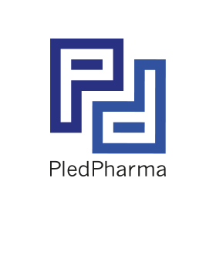

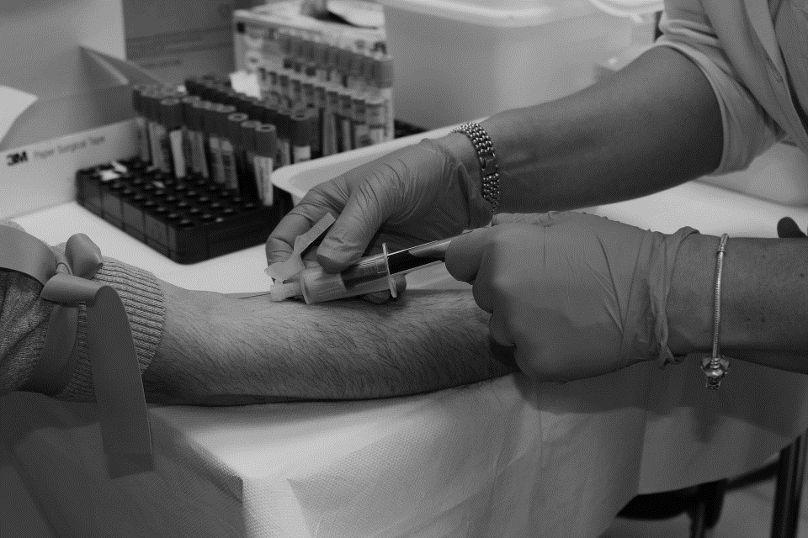
PledPharma
Presentation – Pareto Securities Healthcare Conference
Sept 2nd, 2020
Nicklas Westerholm, CEO

Slide 2
Disclaimer
IMPORTANT: You must read the following before continuing. The following applies to this document, the oral presentation of the information in this document by PledPharma AB (the “Company”) or any person on behalf of the Company, and any question-and-answer session that follows the oral presentation (collectively, the “Information”). In accessing the Information, you agree to be bound by the following terms and conditions.
The Information is confidential and may not be reproduced, redistributed, published or passed on to any other person, directly or indirectly, in whole or in part, for any purpose. This document may not be removed from the premises. If this document has been received in error it must be returned immediately to the Company.
The Information is not intended for potential investors and does not constitute or form part of, and should not be construed as an offer or the solicitation of an offer to subscribe for or purchase securities of the Company, and nothing contained therein shall form the basis of or be relied on in connection with any contractor commitment whatsoever. This document and its contents may not be viewed by persons within the United States or “U.S. Persons” (as defined in Regulation S under the Securities Act of 1933,asamended (the “Securities Act”) unless they are qualified institutional buyers “QIBs” as defined in Rule 144A under the Securities Act. By accessing the Information, you represent that you are (i): a non-U.S. person that is outside the United States or (ii) a QIB. This document and its contents may not be viewed by persons within the United Kingdom unless they are persons with professional experience in matters relating to investments falling within Article 19(5) of the Financial Services and Markets Act 2000 (Financial Promotion) Order 2005 as amended (the “Order”), or high net worth entities falling within Article 49(2)(a) to (d) of the Order (each a “Relevant Person”). By accessing the Information, you represent that you are: (i) outside the United Kingdom or (ii) a Relevant Person.
The Information has been prepared by the Company, and no other party accepts any responsibility whatsoever, or makes any representation or warranty, express or implied, for the contents of the Information, including its accuracy, completeness or verification or for any other statement made or purported to be made in connection with the Company and nothing in this document or at this presentation shall be relied upon as a promise or representation in this respect, whether as to the past or the future.
The Information contains forward-looking statements. All statements other than statements of historical fact included in the Information are forward-looking statements. Forward-looking statements give the Company’s current expectations and projections relating to its financial condition, results of operations, plans, objectives, future performance and business. These statements may include, without limitation, any statements preceded by, followed by or including words such as “target,” “believe,” “expect,” “aim,” “intend,” “may,” “anticipate,” “estimate,” “plan,” “project,” “will,” “can have,” “likely,” “should,” “would,” “could” and other words and terms of similar meaning or the negative thereof. Such forward-looking statements involve known and unknown risks, uncertainties and other important factors beyond the Company’s control that could cause the Company’s actual results, performance or achievements to be materially different from the expected results, performance or achievements expressed or implied by such forward-looking statements. Such forward-looking statements are based on numerous assumptions regarding the Company’s present and future business strategies and the environment in which it will operate in the future.
No representation, warranty or undertaking, express or implied, is made as to, and no reliance should be placed on, the fairness, accuracy, completeness or correctness of the Information or the opinions contained therein. The Information has not been independently verified and will not be updated. The Information, including but not limited to forward-looking statements, applies only as of the date of this document and is not intended to give any assurances as to future results. The Company expressly disclaims any obligation or undertaking to disseminate any updates or revisions to the Information, including any financial data or forward-looking statements, and will not publicly release any revisions it may make to the Information that may result from any change in the Company’s expectations, any change in events, conditions or circumstances on which these forward-looking statements are based, or other events or circumstances arising after the date of this document. Market data used in the Information not attributed to a specific source are estimates of the Company and have not been independently verified.

Slide 3
Agenda
1. Year to date in brief
2. PledPharma today
3. Aladote
4. PledOx
5. Summary and Q&A

Slide 4
Year to date in brief
January 8: Following interactions in late 2019 with the FDA and the European Medicines Agency (EMA), the development strategy for Aladote was finalized, consisting of one pivotal Phase II/III study. Further interactions with FDA and EMA planned for 2020.
January 23: US Food and Drug Administration (FDA) issued a clinical hold in the US of the pivotal phase III POLAR program for PledOx®
March 1: Dosing of patients in the pivotal phase III POLAR program for PledOx is put on hold after interactions with the French regulatory authority, ANSM
April 6: PledPharma decision to close the POLAR program, with a data cut-off targeted for the third quarter and subsequent data read out of efficacy & safety
June/July: Positive pre-clinical results with PledOx presented at Peripheral Nerve Society’s annual meeting and published in the peer-reviewed journal Antioxidants

Slide 5
PledPharma today
Aladote is an important opportunity to address the high unmet medical need to prevent liver injury after paracetamol overdose (Orphan drug designation in the US)
  Full focus on the forthcoming regulatory interactions and pivotal Phase II/III study
  No severe allergic-hypersensitivity reactions reported after single-dose administration in the clinical trials with calmangafodipir
Phase III POLAR program data read-out will determine path forward for PledOx to prevent nerve damage associated with chemotherapy
  Data collection ongoing and a cut-off targeted for the third quarter this year
  Phase III data from 590 randomized patients will enable an efficacy and safety evaluation and assessment of the benefit/risk of PledOx
Robust cash position (approx. 184 million SEK) reported end of the second quarter 2020

Slide 6



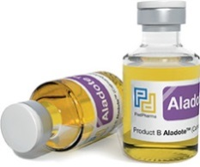
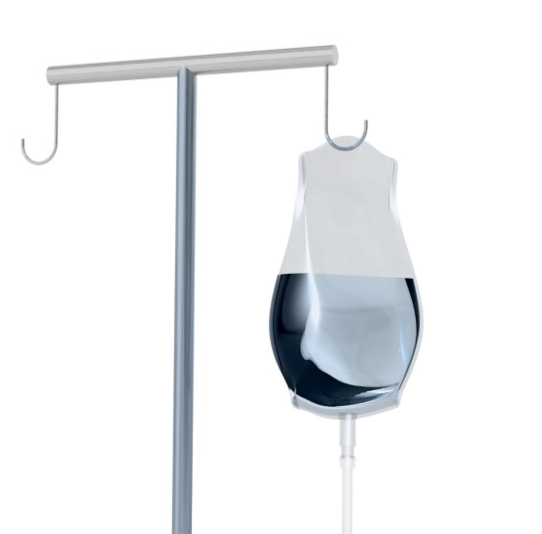

Aladote® – protects the liver and reduces the risk of acute liver failure, Orphan Drug Designation* by the FDA (March 2019)
Aladote®
aims to become new standard of care for patients with increased risk for liver injury
Reduce acute liver injury caused by paracetamol (acetaminophen) poisoning…
Aladote®
Acetylcysteine (NAC)
… in patients with increased risk where treatment of NAC is not adequate:
~ 25% of patients are late arrivals to hospitals (>8h after the overdose)
+
*Qualifies for Orphan Drug Designation in the EU after Brexit

Slide 7






POD incidence in EU5 and US – Hospital visits 2018
105,000
26,000
26,000
9,000
89,000
16,000
Note: Paracetamol (acetaminophen) Overdose 2018 estimate Epidemiology.

Slide 8
Burden on society: POD US Healthcare Costs were $1bn in 2010
US annual costs in 2010 estimated at >$1bn to treat patients with POD
The POD Emergency Department and inpatient cost is around $13,000-40,000
Average POD inpatient length of stay was 3.1 days, with a variance of + 4.4 days for the most severe cases
US liver transplant costs
$125,000-475,000
Note: Adapted from: Altyar A. Clinical and economic characteristics of emergency department visits due to acetaminophen toxicity in the USA BMJ Open 2015;5

Slide 9
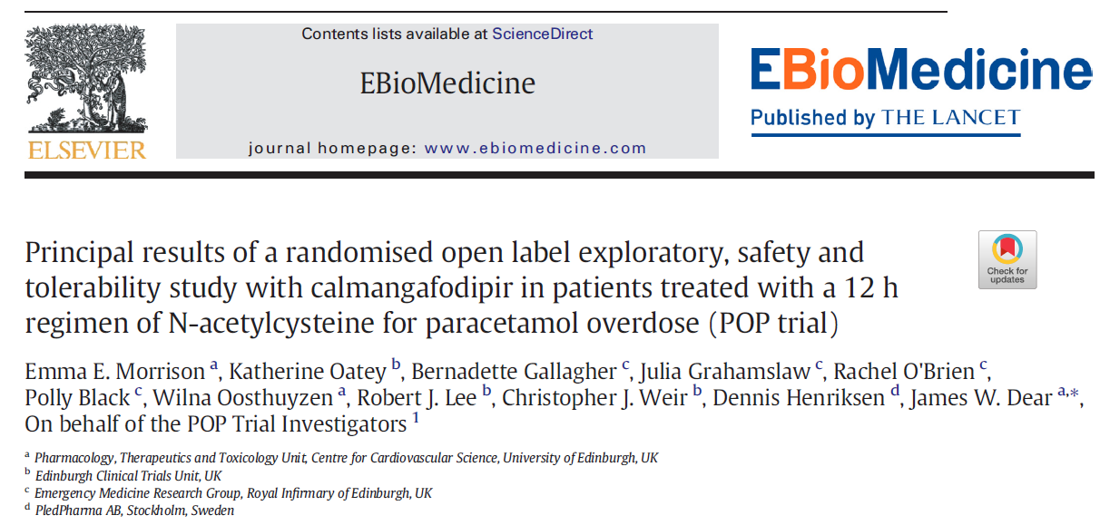
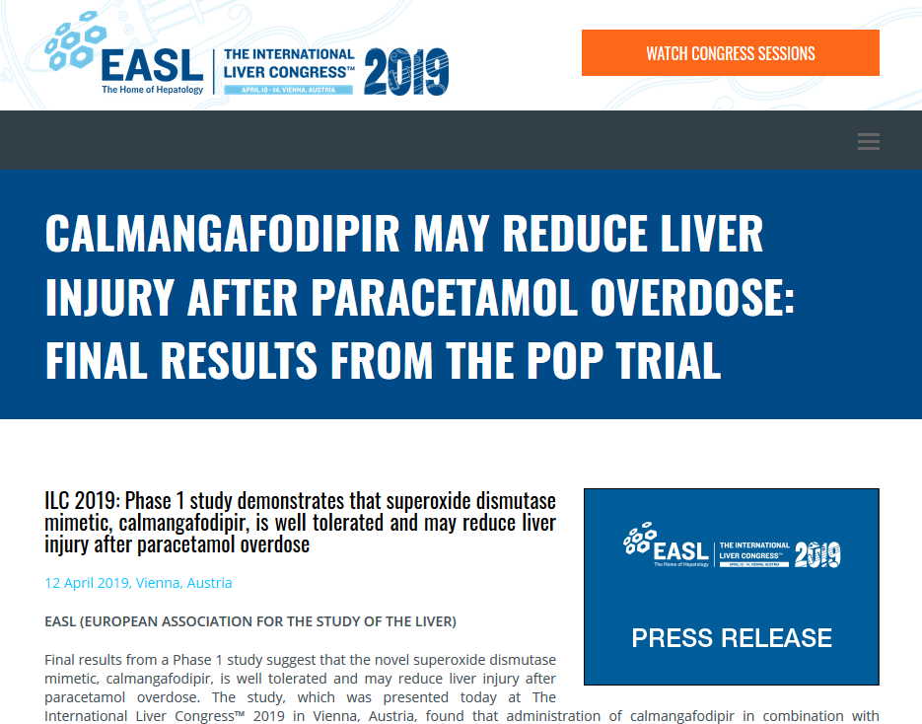
Aladote® positive clinical data from Phase Ib/IIa Study
Phase Ib/IIa Study – Positive results announced in 2018/19
Randomized Phase Ib/IIa in paracetamol overdosed patients
In total 24 patients, were recruited to three Aladote® doses as add-on to NAC regime versus NAC alone
Met the primary endpoint of safety and tolerability in the combination of Aladote® and NAC
Results indicate that Aladote® may reduce liver injury based on measurement of the pre-defined secondary outcomes such as ALT, Keratin-18 (K18) and microRNA-122 (miR-122) in patients treated with Aladote® and NAC compared to NAC alone¹
LANCET EBioMedicine
Press Release from EASL
Clinical Study results presented at the 58th Annual Meeting of the Society of Toxicology in March, in Baltimore, at EASL ILC in April, Vienna and published in Lancet’s journal EBioMedicine in July 2019

Slide 10
Planned Pivotal Phase II/III study with Aladote®
Tentative study design pending regulatory interaction
Patient population | Increased risk POD patients, Late arrivals (>8h) requiring treatment with NAC
NAC regims | Standard of care, 21 hr NAC regime
Initiation of randomized treatments | IV as soon as possible after randomization and after starting NAC (but no later than 4 hours after starting NAC)
Treatment arms | 3 arms Aladote high-dose on top of NAC; Aladote low-dose on top of NAC; Placebo on top of NAC
Interim analysis | Includes a futility analysis and dose selection where the most effective dose will be continued
Sample size | TBD
Efficacy endpoints | ALT INR Number (%) of patients that need further NAC after 21hrs Length of hospital stay Experimental biomarkers, K18, miR-122 and GLDH
Study regions | EU and US
Note: (1) regulatory interactions for development program held with FDA and EMA Q4 2019, regulatory interactions to finalize specific study details planned for Q2/3 2020
.

Slide 11
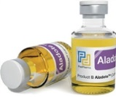
Aladote® – timeline
ü
US Orphan Drug Designation
Presentation of study results at Society of Toxicology
Presentation of study results EASL ILC
Presentation of results in Lancet EBiomedicine
Regulatory interactions FDA & EMA – development program
ü
ü
2032⁽¹⁾
2022/23
Regulatory submissions start
2019
ü
ü
ü
Ph Ib/IIa study fully recruited
Initial Results Ph Ib/IIa study
Established Scientific Advisory Board
Full results Ph Ib/IIa study
Submission of Orphan Drug Designation
Regulatory interactions FDA & EMA
Initiate pivotal Phase II/III study
2023/24
2018
ü
2020
First launch
ü
ü
ü
(1) Calmangafodipir composition of matter patent expires

Slide 12
Aladote® – Commercial potential in POD patients
Hospital admissions POD patients in US and EU5 /year
Pricing assumption
~5,000
USD/dose in the US¹
~135,000
COGS assumption
Low single digit percent
Note: (1) Up to $5000 based on initial and limited research

Slide 13
PledOx POLAR Phase III program
POLAR program, two double blinded randomized placebo-controlled phase III trials
  POLAR-A , fully recruited in December 2019
  POLAR-M, not fully recruited
  No further recruitment and dosing of patients, data collection ongoing
Total Phase III data generated in the POLAR program will enable a thorough efficacy and safety evaluation and an assessment of the benefit/risk of PledOx
  590 patients out of the planned 700 patients have been randomized
  Majority of patients expected to have a substantial treatment effect of PledOx despite dosing of patients stopped prematurely
  420 patients have completed more than 6 cycles of treatment with study drug
Data cut-off by third quarter selected so all patients eligible for 6 cycles of treatment with study drug have completed the 9-month data collection of the primary endpoint

Slide 14
Summary and Q&A
Aladote is an important opportunity to address the high unmet medical need to prevent liver injury after paracetamol overdose (Orphan drug designation in US)
  Full focus on the forthcoming regulatory interactions and pivotal Phase II/III study
Phase III POLAR program data read-out will determine path forward for PledOx to prevent nerve damage associated with chemotherapy
  Data collection ongoing and a cut-off targeted for the third quarter this year
Robust cash position (approx. 184 million SEK) reported end of the second quarter 2020

Slide 15
PledPharma
Presentation – Pareto Securities Healthcare Conference
Sept 2nd, 2020

Slide 16
Design of Aladote Phase Ib/IIa clinical study completed in 2018
Randomised Open Label Exploratory, Safety and Tolerability Study with Calmangafodipir in Patients Treated with the 12-hour Regimen of N-Acetylcysteine (NAC) for Paracetamol Overdose
Cohort 3
Design
  Single ascending dose study in 3 dosing cohorts of 8 patients (N=24) as add-on to NAC regime
Aladote 10 µmol/kg
add-on to NAC (N=6)
NAC alone
(N=2)
Cohort 2
Patients
  Admitted to hospital within 24h of paracetamol overdose requiering NAC treatment
Aladote 5 µmol/kg
add-on to NAC (N=6)
Treatment period
(up to 22h)
90 days
follow-up
NAC alone
(N=2)
Cohort 1
Treatment
Aladote/Placebo administered 2 hrs after NAC loading dose
Aladote 2 µmol/kg
add-on to NAC (N=6)
Treatment period
(up to 22h)
90 days
follow-up
NAC alone
(N=2)
Endpoints
  Safety and tolerability Biomarkers¹ of liver status
Treatment period
(up to 22h)
90 days
follow-up
Note: (1) Conventional biomarker ALT and experimental biomarkers such as microRNA-122 (miR-122) and Keratin-18 (K18)

Slide 17
Aladote®: About biomarkers
ALT
Alanine transaminase (ALT) is a transaminase enzyme also called alanine aminotransferase (ALAT). ALT is found in plasma and in various body tissues especially the liver’s hepatocytes. Serum ALT is commonly measured clinically as part of a diagnostic evaluation of hepatocellular injury, to determine liver health. However, ALT has sub-optimal sensitivity and specificity particularly early after paracetamol overdose. Reference: K. Al-Hourani et al. Q J Med 2013; 106:541–546
Keratin-18 (K18)
In paracetamol overdose, the full-length variant of K18 is released by necrotic cell death. A shorter, caspase cleaved form of K18 is released following cell apoptosis (programmed cell death). Both forms of K18, measured in the first serum sample at presentation at the hospital after paracetamol overdose, correlate with peak ALT activity during the hospital stay. Full length K18 distinguished patients with and without acute liver injury at an early time where ALT activity was still normal. This is consistent with necrosis being more prominent than apoptosis in the pathophysiology of paracetamol-induced acute liver injury.
References: JW Dear et al. Lancet Gastroenterol Hepatol 2018; 3: 104–13; ADB Vliegenthart et al. Br J Clin Pharmacol. 2015; 80: 351–362.
microRNA-122 (miR-122)
miR-122 is a biomarker specific for liver injury and fully conserved (translational) across in vitro models, in vivo models and humans. MiR-122 is an early marker for acute liver injury which predicts a rise in ALT activity following paracetamol overdose. When miR-122 was measured at hospital presentation after a paracetamol overdose in patients requiring subsequent NAC therapy the circulating miR-122 concentration correlated significantly with peak hospital stay ALT activity. MiR-122 was significantly higher in those patients who developed subsequent acute liver injury. miR-122 can accurately separate patients with and without acute liver injury at an early time when ALT activity was still normal. This is consistent with miR-122 having enhanced sensitivity and specificity in this context of use.
References: JW Dear et al. Lancet Gastroenterol Hepatol 2018; 3: 104–13; ADB Vliegenthart et al. Br J Clin Pharmacol. 2015; 80: 351–362.

Slide 18
Allergic-hypersensitivity reactions
The safety of patients in our clinical studies is our most important responsibility
Allergic-hypersensitivity reactions are not uncommon in relation to platinum-based chemotherapy, but the DSMB recommendation to stop the POLAR studies implies that such risk is increased with PledOx
About the observed events:
  No reason to believe that patients previously treated with study drug is currently at risk
  All of these severe events were transient and resolved after treatment
  All events occurred during the administration of oxaliplatin or study drug.
  All events occurred after repeated dosing of study drug. There has been no severe event observed before the 6th cycle of dosing.
Work ongoing together with external immunology experts to better understand why these allergic-hypersensitivity reactions occur

