Slide 1
Probi AB
Pareto Health Care Conference
September 3, 2020
Tom Rönnlund, CEO
Henrik Lundkvist, CFO

Slide 2
Safe Harbor Statement
This presentation contains certain forward-looking information that reflects Probi’s present view of future events, as well as financial and operational development. Words such as “intend”, “assess”, “expect”, “may”, “plan”, “believe”, “estimate” and other expressions entailing indications or predictions of future development or trends, not based on historical facts, constitute forward-looking information. Forward-looking information is inherently associated with both known and unknown risks and uncertainties as it depends on future events and circumstances. Forward-looking information is not a guarantee of future results or development and actual outcomes may differ materially from the statements set forth in the forward-looking information. Given the risks associated with forward-looking statements, recipients of this presentation are cautioned not to place undue reliance on these forward-looking statements. The forward-looking statements referred to above speak only as at the date of the presentation. Probi will not undertake any obligation to release publicly any revisions or updates to these forward-looking statements to reflect future events, circumstances, anticipated events, new information or otherwise except as required by law or by any appropriate regulatory authority.
Probi does not make any guarantee, representation or warranty, express or implied, as to the accuracy, completeness or fairness of the information and opinions contained in this presentation, and no reliance should be placed on such information. Probi does not accept any responsibility or liability whatsoever for any loss howsoever arising from any use of this presentation or its contents or otherwise arising in connection therewith.

Slide 3
Agenda
1 | Introduction
2 | Company presentation
3 | Half-year update
4 | Outlook
5 | Q & A

Slide 4


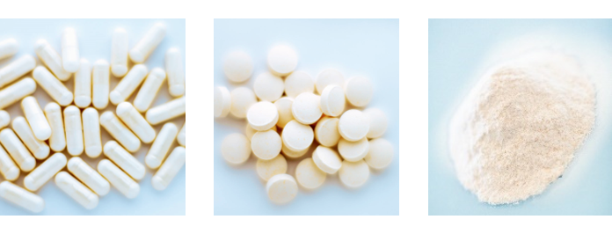


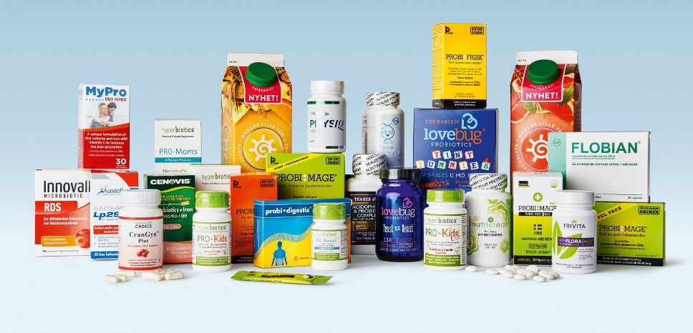


Probi – “First in probiotics”
Founded 1991
420 patents
40 markets
626 MSEK Net Sales
183 MSEK EBITDA
170 employees
4 bn SEK Market Cap

Slide 5





Trends driving future probiotics markets
Scientific progress leading to new applications
Probiotics - Supplements
Expected global growth 2019-2024
(USD bn consumer value)*
Higher proportion of older people
CAGR +4%
7.4
6.1
Higher living standards and interest in probiotics in new countries
E-commerce growth
2019
2024
* Source: Global Probiotics Market Insights – Euromonitor December 2019

Slide 6
Probi AB
One of the leading probiotic companies in the world

Slide 7
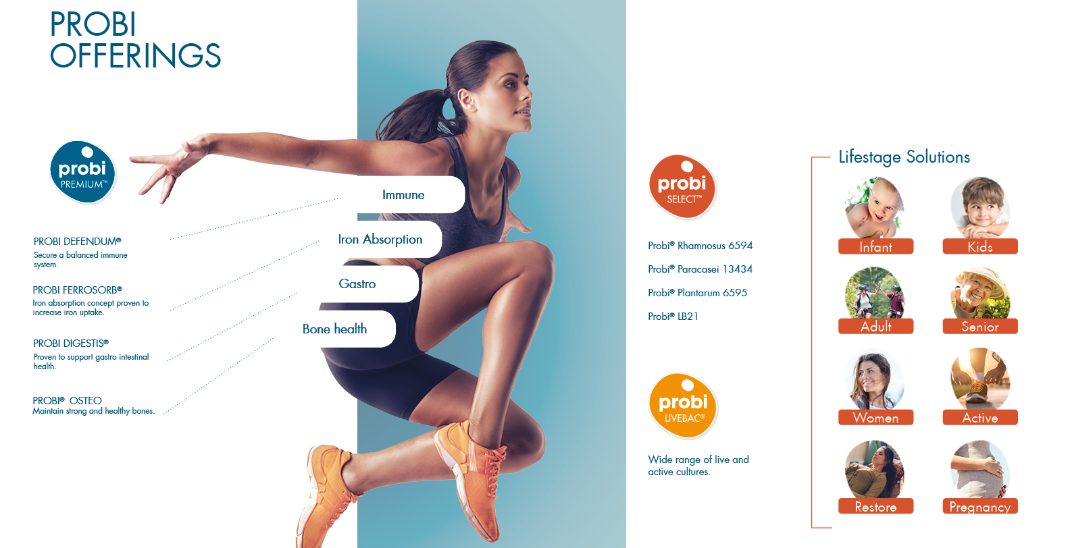
Probi offering

Slide 8
Probi global footprint
Lund
HQ and R&D
Redmond
Fermentation
Region Americas
72% of
net sales
Region EMEA
19% of net sales
Region APAC
9% of
net sales
Lafayette
Finished formats
Singapore
Sales office

Slide 9
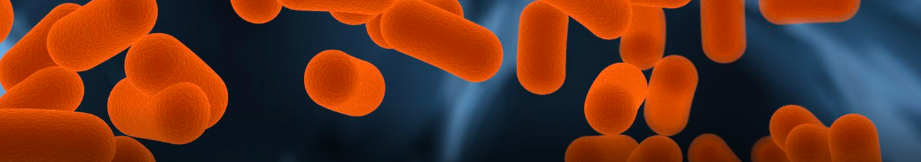
Probi – a scientific pioneer in probiotics
>100
>270
>420
Clinical trials have been carried out
Scientific
Publications
Granted Patents

Slide 10
Half-year update

Slide 11

Probi – first six months in 2020
Strong underlying demand for probiotics
Strategic Joint Venture with US-based Viva5 Corporation
Strengthened partnership with one of our largest American customers
Pan-European partner agreement with launch in 15 European countries from 2021
Manufacturing facility upgrade program on schedule
Updated financial targets

Slide 12
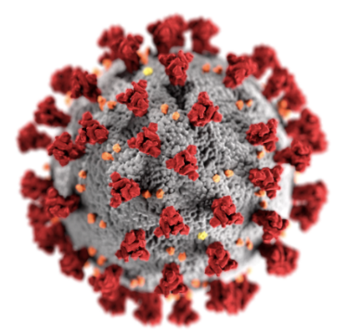
Impact on Probi by Covid-19 pandemic
Market reactions
Increased demand for immune supporting products
Heightened focus on personal health supports demand in US market
Growth in e-commerce channel
Business impact on Probi
Limited Covid-19 related cost increases
Maintaining full operational status at manufacturing facilities
Societal lock-downs resulted in customer stock building in EMEA and APAC

Slide 13
H1 2020 - Healthy growth in Net Sales
Net sales
SEK m, sales growth in % (constant currency growth)
Highlights in the period
+6%
Net sales +6% compared to H1 2019
Strong underlying demand for probiotics in region Americas
Product mix and temporary disruptions in production had negative impact on gross margin
Reduced operational expenses lifting EBITDA-margin to 26%
Expecting higher volatility in sales revenues coming quarters by Covid-19 effects and large US customer update of product range
(+4%)
H1 2019
H1 2020
EBITDA
SEK m, EBITDA margin as % of Group net sales
+4%
26,6%
26,1%
H1 2019
H1 2020

Slide 14
H1 2020 - Net Sales and Gross Profit by region
Americas
EMEA
APAC
+6%
Net Sales, SEK m
sales growth in %
-2%
+25%
H1 2019
H1 2020
H1 2019
H1 2020
H1 2019
H1 2020
Gross Profit, SEK m
H1 2019
H1 2020
H1 2019
H1 2020
H1 2019
H1 2020
Gross Margin
40%
37%
64%
59%
62%
53%

Slide 15
Solid balance sheet with no external loans
Balance sheet Probi Group as per June 30, 2020
SEK m
Key aspects
Total equity of SEK 1 181 m
No external loans
Equity ratio 90%
1 311
1 311
Non-current assets
Equity
Current assets
Non-current liabilities
46
Current liabilities
84
Assets
Liabilities & Equity

Slide 16
Outlook

Slide 17
We will double in size and increase profitability
Doubled sales
Lead the way in probiotic innovation and science
Manufacturing excellence
Growth
Accelerate development of new products
More efficient manufacturing
Stronger presence in growth markets
Solidify position in premium probiotic segments
Strategic partnerships
Acquisitions
Expand range of clinically documented offerings
Increase international collaborations
Evaluate growth potential in probiotic related market segments
High quality production adapted to market needs
New manufacturing capabilities in growth regions
Gradually improved gross margins
Growth focus

Slide 18
Thank you &
Q & A

